Slide 1
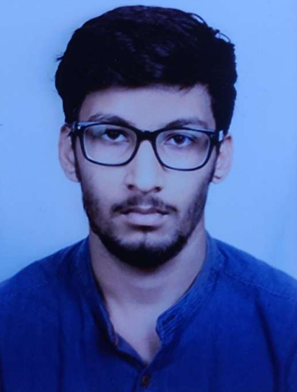


Varun Maheshwari
Analyst
Bachelor of Engineering
Computer Science : 2018 - 2022
Skills Java 8 /J2EE
Spring Boot
Spring MVC
JPA CRUD
Bootstrap
MERN Stack
Angular
MongoDB
Database
No SQL database – MongoDB
Web Technologies
HTML5
CSS3
Javascript
AddOns
Github
Maven
Postman
Additional Details
Leadership
Excellent Communication Skills
Team management
Chennai
varun.maheshwari@capgemini.com
+91 8800453341
A4
Software Engineer who is Strong in design and integration with intuitive problem-solving skills. Passionate about implementing and launching new projects.
Ready to learn new technologies and implement them to further improve my knowledge.
Eager to work in a team of dedicated people and serve a key role in the enhancement and development of the project.
Has working knowledge on Angular and Java Microservice Development using Spring framework on an intermediate level..
Deals and Coupon Finder Website
Completed end to end case study of Deals and Coupon Finder using Spring Microservices along with Eureka Server, Zuul Api Gateway, Swagger implementation and Google Authentication. Material-UI and Angular Bootstrap used for user interface.
Completed Agile Software Development from Coursera.
Completed AWS Cloud Practitioner Certification.
https://www.linkedin.com/in/varun-maheshwari-b937801b6
Check out my work on GitHub:- https://github.com/m-Varun63

